Slide 1
Support Vector Machine (SVM) Algorithm
An Introduction

Slide 2
CONTENTS
1. Theoretical Overview:
1.1 Classifications Models
1.2 Decision Boundaries
1.3 Margins
1.4 Support Vectors
1.5 Slack Parameter
1.6 Regularization
1.7 The Kernel Trick
1.8 How to find the extremum (learning)
2. Practical Example: Classification Problem
2.1 Heart Disease Dataset
2.2 Features Description
2.3 Implémentation de l’algorithme
2.3.1 En utilisant la bibliothèque prédéfinie
2.3.2 En implémentation native
2..3.3 Explication du principe de fonctionnement
2.4 Evaluation methods
2.4.1 Évaluation du modèle prédéfini (scikit-learn)
2.4.2 Évaluation du modèle native
2.4.3 Évaluation de deux approches
2.5 Conclusion

Slide 3
1. THEORITICAL OVERVIEW
In this section, we will:
Go over the basic ML concepts that the SVM algorithm is built upon
Explain how SVM differs from other margin classifiers
Explain the concepts that make the SVM algorithm so powerful

Slide 4
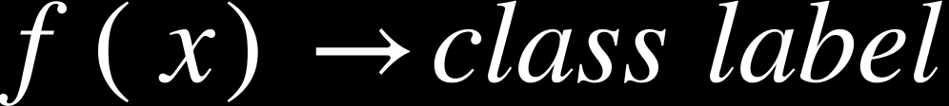
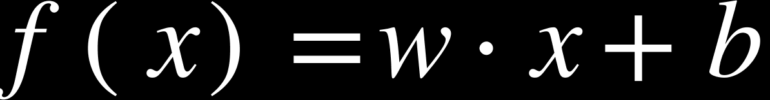




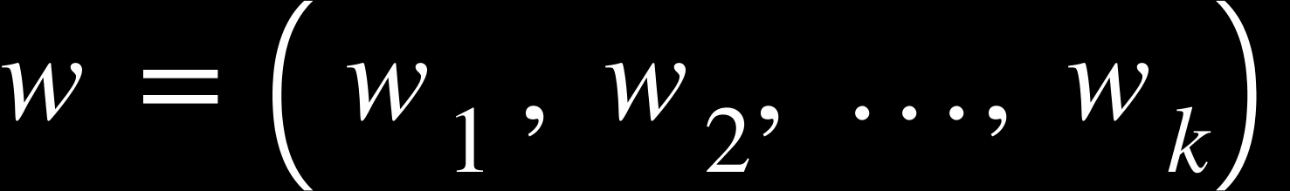
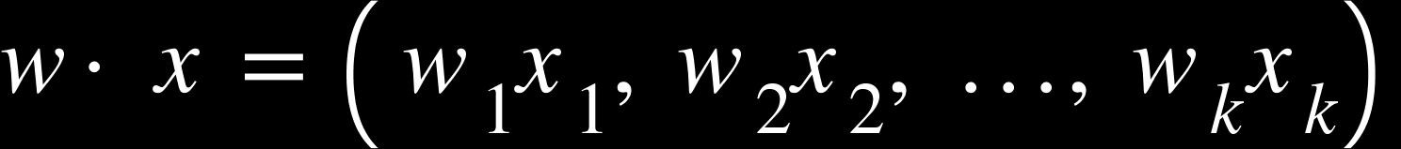
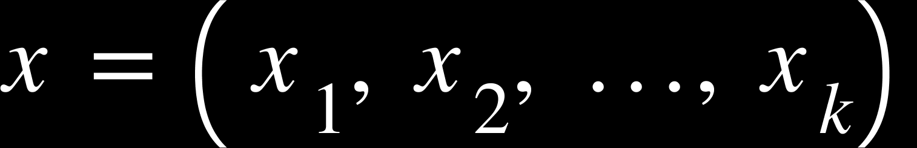
1.1 CLASSIFICATION MODELS
A classification model learns a function such that when given an input feature vector `x`, it predicts a discrete output such as:
0 or 1
Cat / Dog
Class A, B, C
Mathematical View
In SVMs, the model’s equation is defined as a linear function
Where is a weight vector and is called a bias. The operation between and is a dot product
•
and,
•

Slide 5
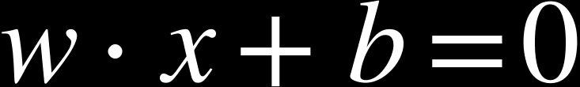
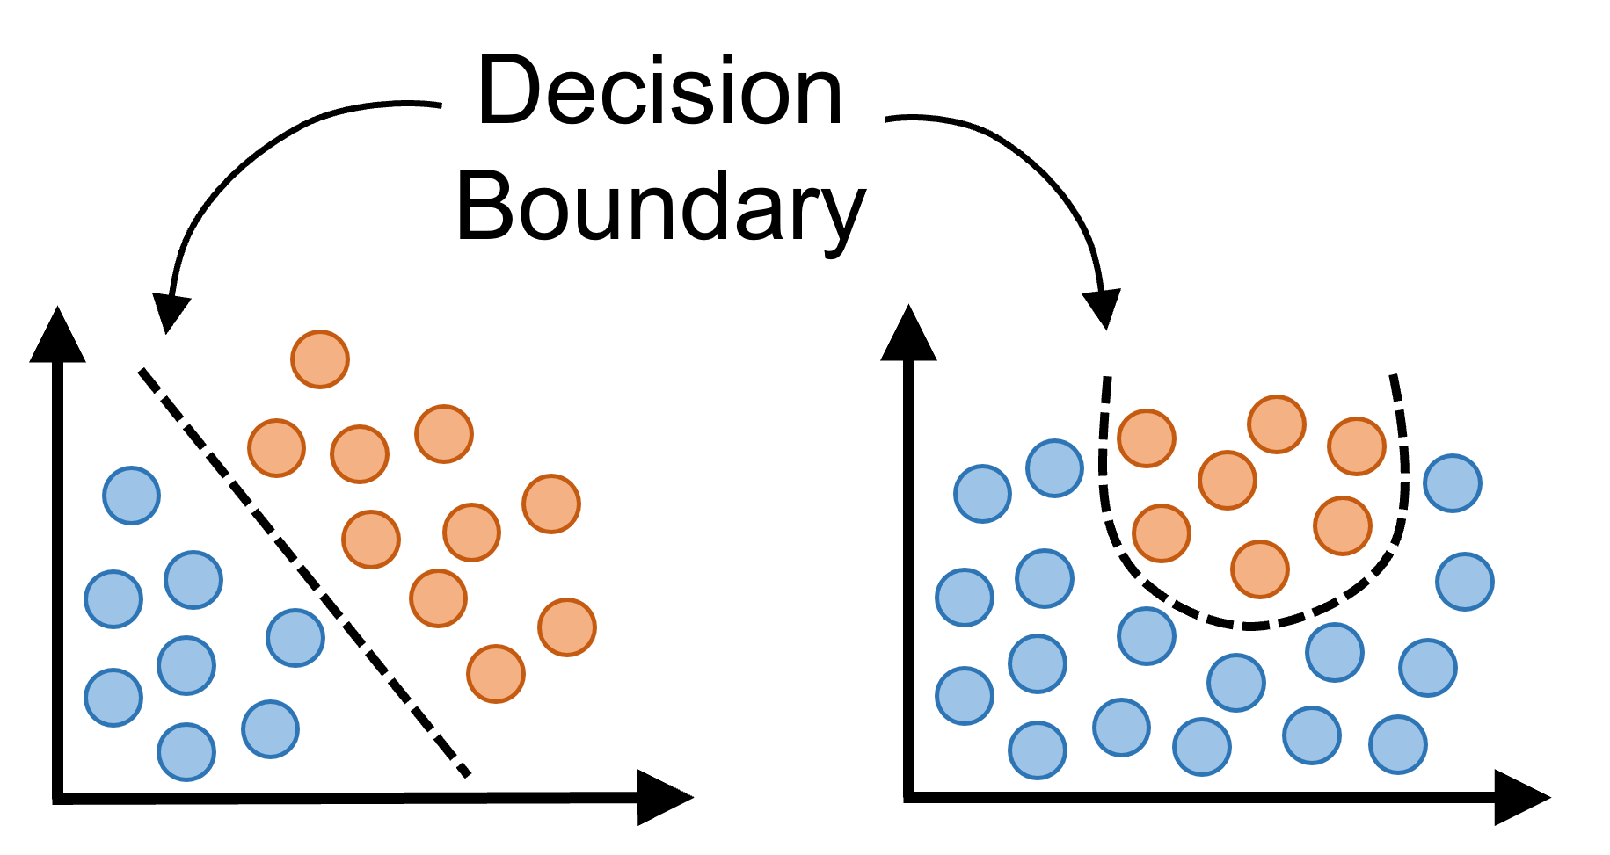
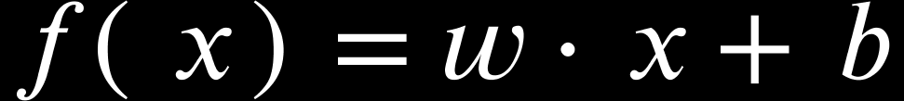


1.2 DECISION BOUNDARIES
You might intuitively think about it like a line separating two sets of points in a plane such that positive and negative examples would respectively be above and below it. More formally, The decision boundary is the set of all points where the model is exactly undecided, such that,
`positive and negative examples` here refers to the sign of such that:
If point x is above the boundary:
Else, If it is below it:
In non-linear models, the function of boundary would be some complicated function with exponents like

Slide 6
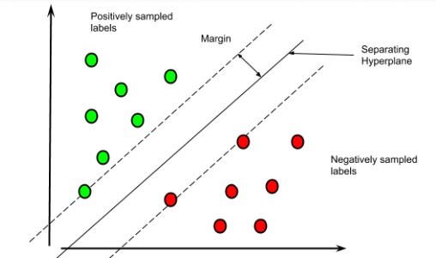
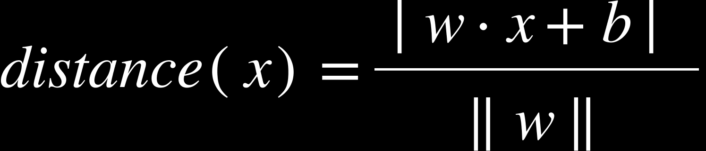
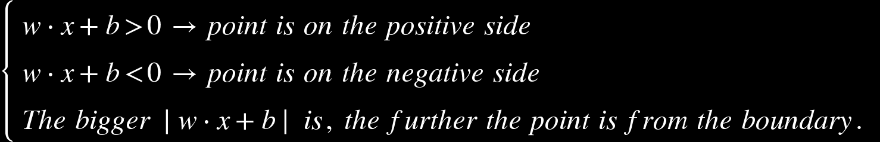
1.3 MARGINS
The margin is the distance between:
A point and the decision boundary, or
For SVM: distance between the boundary and the closest points
Distance from a point to the boundary:
Is a geometric distance if

Slide 7
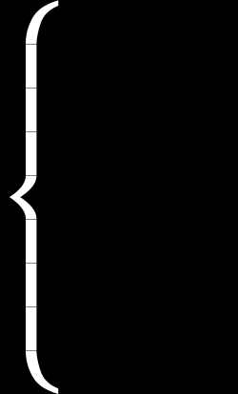
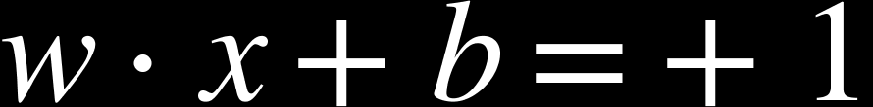
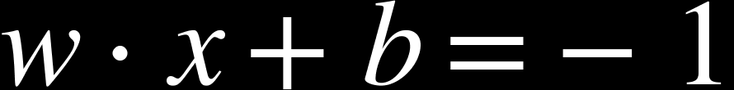
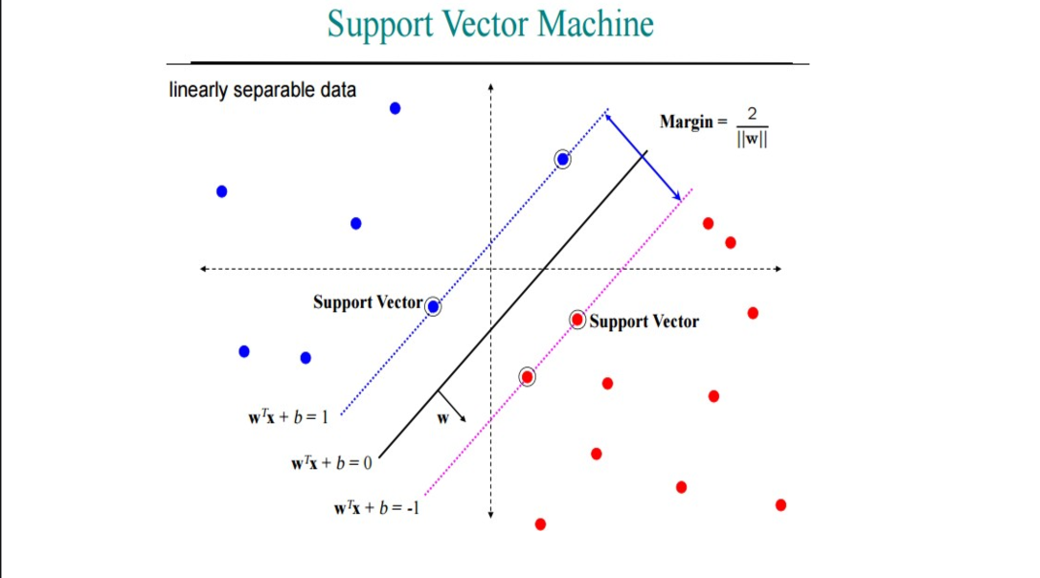
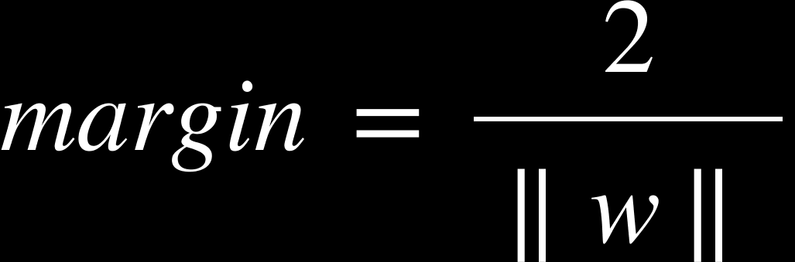
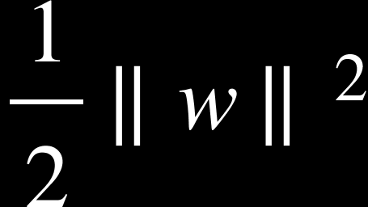
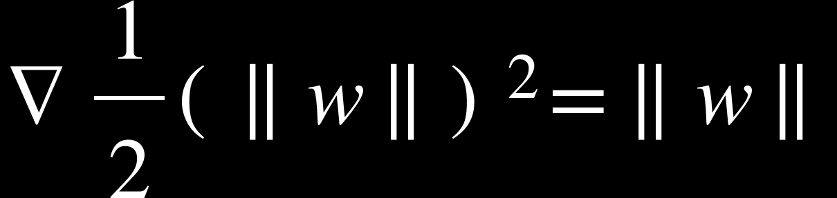
1.4 SUPPORT VECTORS
SVM tries to find the boundary that maximizes the margin, i.e., separates classes as widely as possible. For that, SVM defines two support boundaries:
as the slope of the closest example from the boundary
as the slope of the furthest example from the boundary
The margin width is the distance between these two lines.
Computing it, we find the Distance between parallel
hyperplanes:
Important:
Large margin → small ∥w∥
SVM optimization tries to minimize because it has a
clean gradient:
THE GENIUS IDEA OF SVM

Slide 8
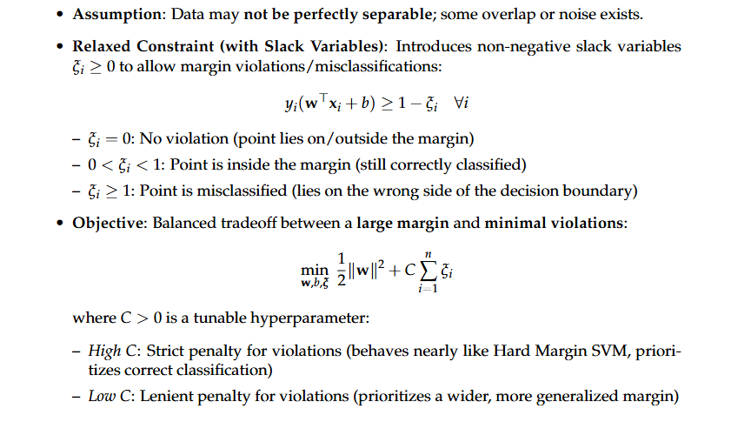
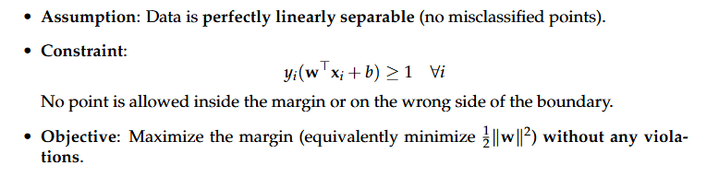
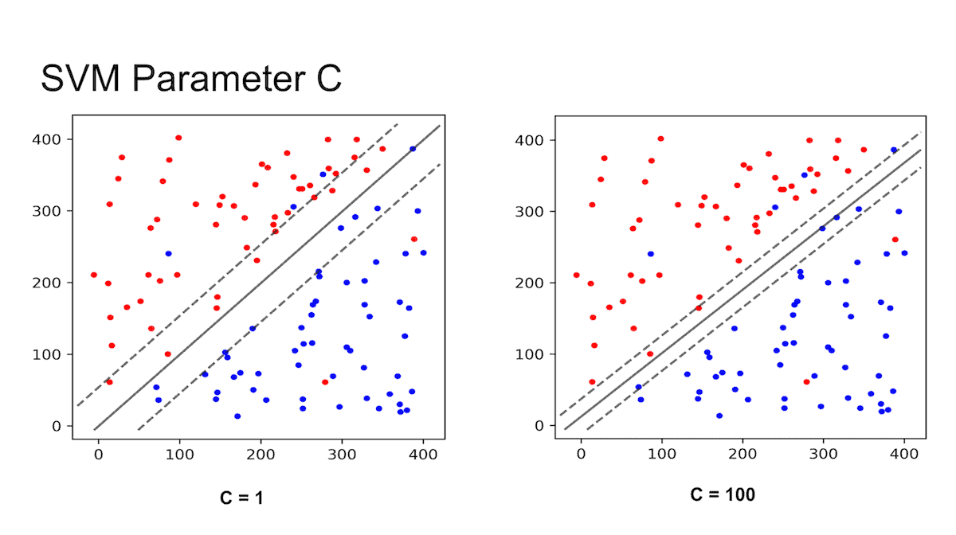
1.5 SLACK PARAMETER

Slide 9
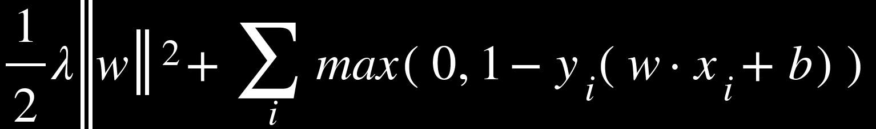
1.6 REGULARIZATION
When implementing a linear SVM using gradient descent, the objective function (to minimize) often looks like this:
That is:
λ controls how strongly you penalize large weights
Larger λ ⇒ more regularization (simpler model, less overfitting)
Smaller λ ⇒ less regularization (more flexible model, but may overfit)
And since weight update (gradient decent, we will see it shortly) usually is
And contains C, λ is basically the SVM's "C" inverse. That is why many gradient-descent formulations use λ = 1/C

Slide 10
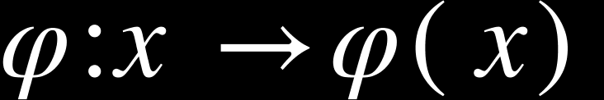
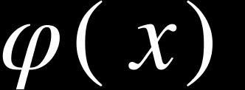
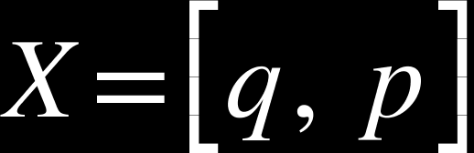
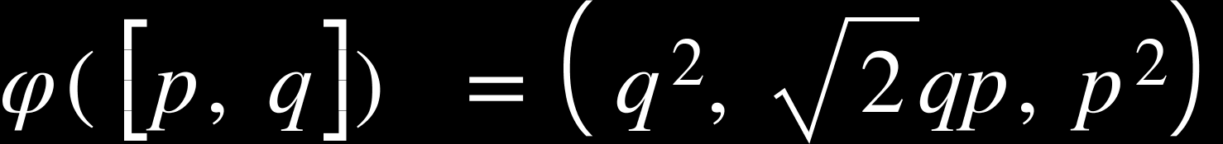
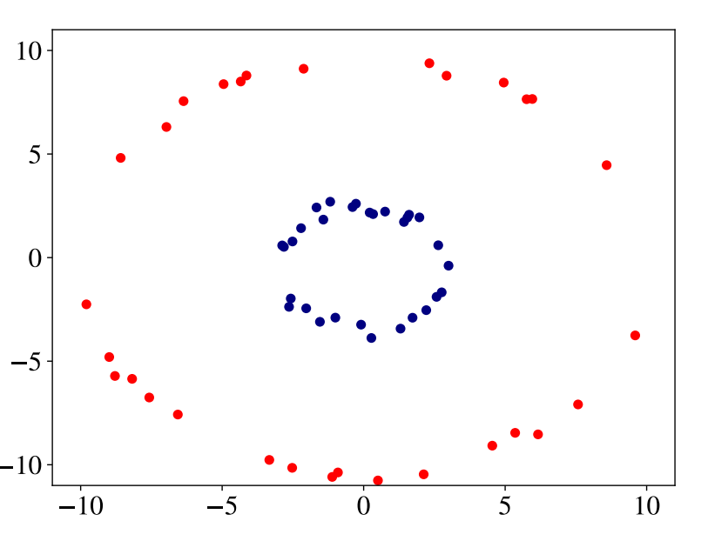
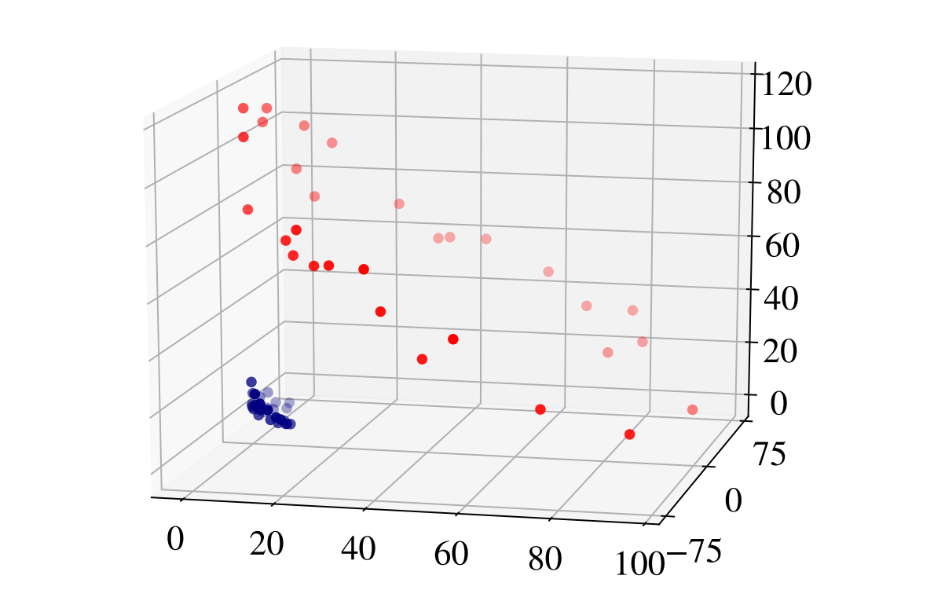
1.7 THE KERNEL TRICK
it’s possible to transform a two-dimensional non-linearly-separable data into a linearly-separable three-dimensional data using a specific mapping where is a vector if higher dimensionality than . For example, take this mapping from 2D to 3D space for each point
and transforms it using:
As Illustrated below:

Slide 11
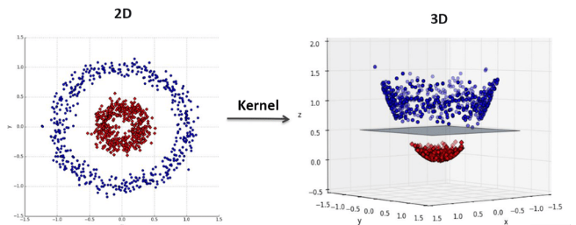
1.7 THE KERNEL TRICK

Slide 12
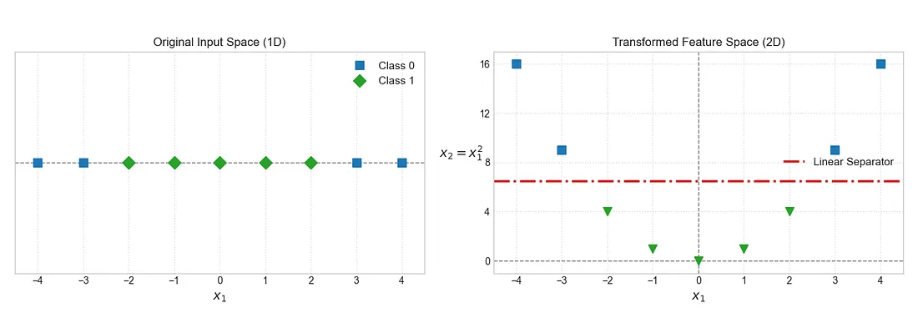
1.7 THE KERNEL TRICK

Slide 13
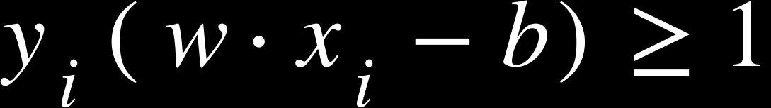
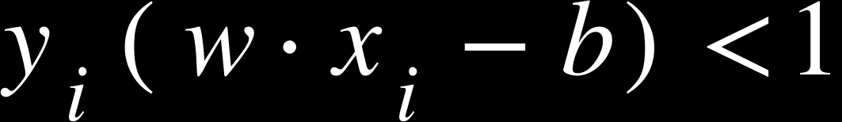
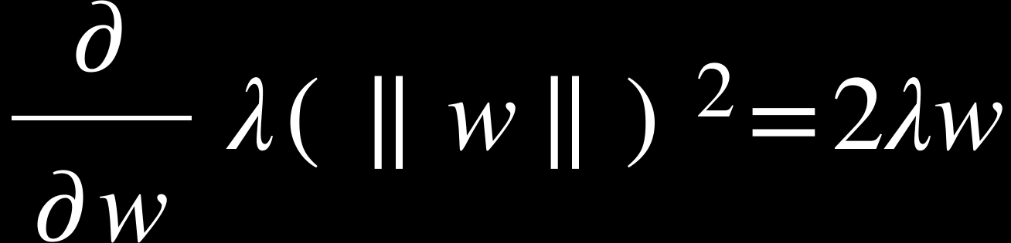
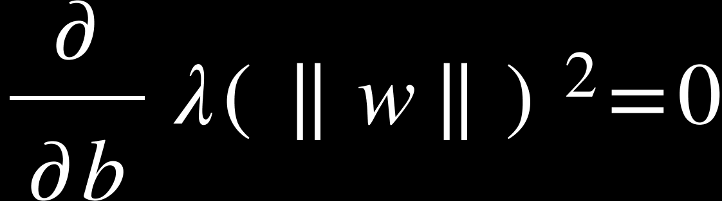
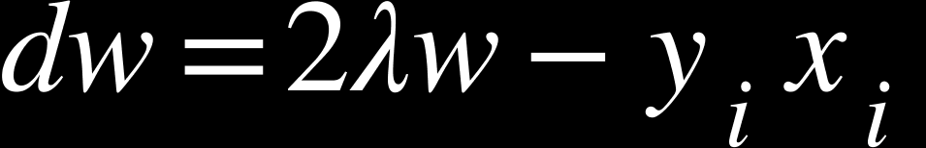
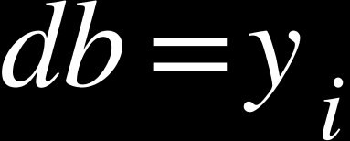
1.8 HOW TO FIND THE EXTREMUM
TERMINOLOGY ALERT: we are looking for the gradient vector (dw, db)
The sub gradient form of the SVM primal hinge loss with L2 regularization function is
it is a mouthful, but it is only a matter of definition. The hinge loss for a point ‘i’ is:
Case 1: Margin satisfied
Which means that the point is correctly classified and outside the margin. So,
and
Case 2: Margin violated
Now hinge loss is active:
and

Slide 14
2 Practical Example: Classification Problem

Slide 15
2.1 Heart Disease Dataset
Medical dataset designed for binary classification tasks.
The dataset is organized in a structured tabular data suitable for SVM
It includes 298 patient records with 13 medical attributes and 1 target
The attributes cover demographic information, clinical test results, and physiological measurements
Most attributes are numeric or can be easily encoded, which is required for SVM-based models.

Slide 16
2.2 Features Description
Age (numeric)
Sex (binary)
Chest pain (categorical)
Resting blood pressure (numeric)
Cholesterol level (numeric)
Fasting blood sugar (binary)
ECG results (categorical)
Maximum heart rate (numeric)
Exercise-induced angina (binary)
Old peak (numeric)
Slope (categorical)
CA nbr of major vessels (numeric)
Thal (categorical)
The target indicates the presence or absence of heart disease and it’s values are binary:
0 → No heart disease
1 → Heart disease detected

Slide 17
2.3 Implémentation de l’algorithme
Pour cette partie, nous avons développé deux programmes : – En utilisant la bibliothèque prédéfinie (sklearn.svm)
– En implémentation native

Slide 18
2.3.1 En utilisant la bibliothèque prédéfinie
Dans cette partie, nous avons utilisé la bibliothèque sklearn.svm, en particulier le modèle LinearSVC.
Avant d’entraîner le modèle, nous avons normalisé les donner (en utilisant StandardScaler)
Ensuite, le modèle a été paramétré comme suit :
LinearSVC(loss = 'hinge', C = 1.0, max_iter = 5000)

Slide 19
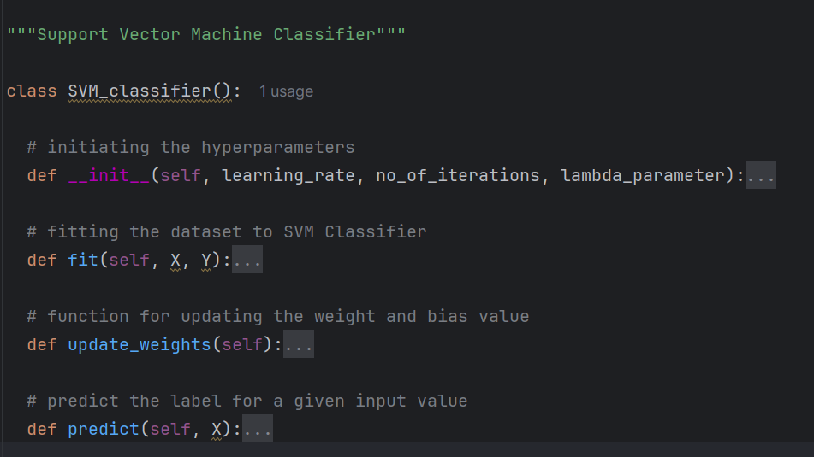
2.3.2 En implémentation native
Pour implémenter la conception du SVM, nous avons créé une classe nommée SVM_Classifier() qui possède la structure suivante:

Slide 20
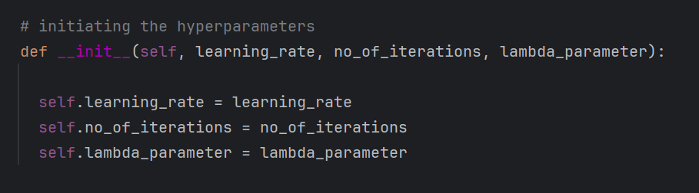
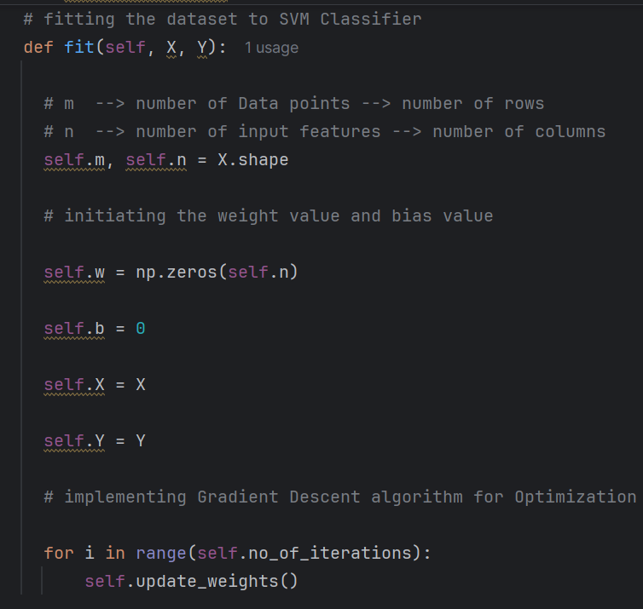
2.3.3 Explication du principe de fonctionnement

Slide 21
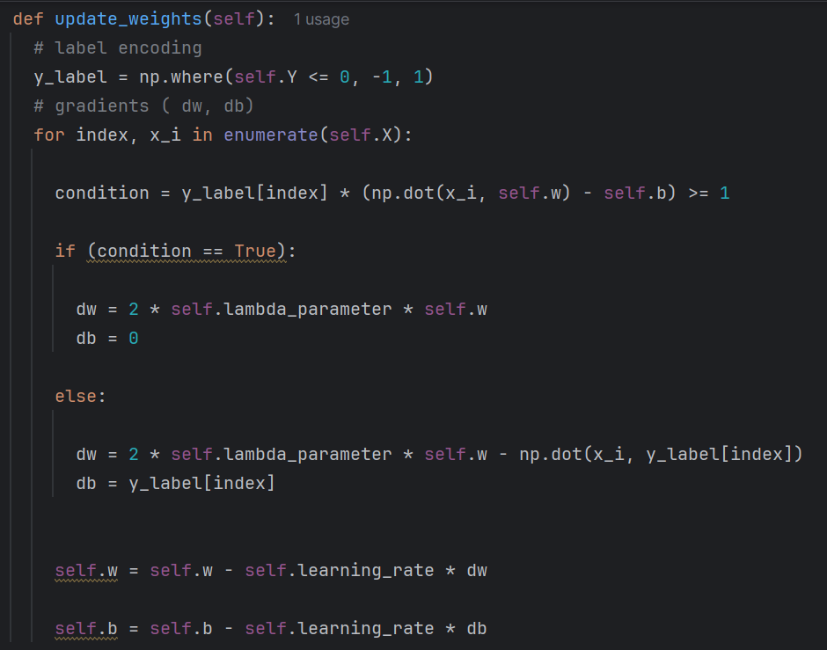
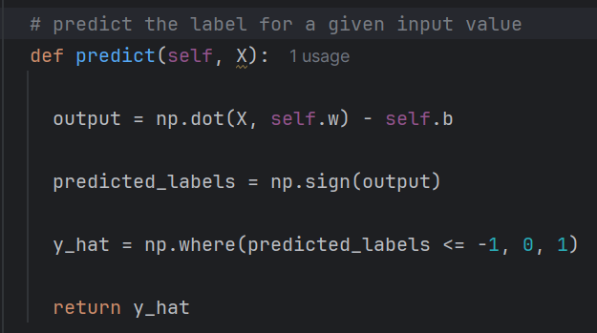

Slide 22
2.4 Evaluation methods
Pour évaluer la performance de chaque modèle, nous avons utilisé les métriques suivantes :
Accuracy Accuracy=(TP+TN)/(TP+TN+FN+FT)
Precision =TP/(TP+FP)
Recall(Sensitivity) Recall=TP/TP+FN
F1_score=2*(Precision *Recall)/(Precision +Recall)
confusion matrix
Et on a pas utiliser MSE et r2_score ,car ils sont destiner a un problem de regression(prédire une valeur continue comme un prix ou une température)

Slide 23
2.4.1 Évaluation du modèle prédéfini (scikit-learn)
Il a donner ces resultants:
Accuracy = 86.67 % (bonnes prédictions globales)
Precision (classe 1 = malade)0.89 → 89 Quand le modèle dit « malade », il a raison 89 % du temps.
Recall (classe 1 = malade)0.80 → 80 %Le modèle détecte 80 % des vrais malades (rate 20 %).
F1-score (classe 1 = malade)0.85 → 85 %Bon équilibre entre précision et recall
 | Predicted maladie | Predicted non maladie
Actual maladie | 33 | 8
Actual non maladie | 4 | 45

Slide 24
2.4.2 Évaluation du modèle native
Il a donner ces resultants:
Accuracy = 80% de bonnes prédictions globales.
Precision (classe 1 = malade)0.78 → 78 %Quand le modèle dit « malade », il a raison 78 % du temps.
Recall (classe 1 = malade)0.78 → 78 %Le modèle détecte 78 % des vrais malades → rate 22%
F1-score (classe 1 = malade)0.78 → 78%Équilibre moyen entre précision et recall
 | Predicted maladie | Predicted non maladie
Actual maladie | 21 | 6
Actual non maladie | 6 | 27

Slide 25
2.4.3 Évaluation de deux approches
En utilisant les métriques calculées, on constate que :
Le SVM Sklearn est globalement plus performant que le modèle natif, avec une meilleure Accuray, Precision ,Recall,f1_score .Le modèle natif fonctionne mais reste moins précis et moins fiable.

Slide 26
2.5 Conclusion
Le svm reste un approche des approches utiliser pour faire la classification a partir de hyperplan en utilisant les support vectours mais il reste d’autre approche qui peux donner des resultant mielleur il faut juste compris bien le problem .

